Slide 1
aI for devops
ow

Slide 2
Overview
AI for code review leverages machine learning models to automatically analyze code, detect issues, and provide recommendations.
It enhances software quality, security, and efficiency by identifying potential bugs, security vulnerabilities, and performance bottlenecks.
At its core, Predictive DevOps is a convergence of data-driven intelligence with operational agility. It represents an evolutionary step in the DevOps journey, transcending the traditional boundaries of reactive operational practices.

Slide 3
Key Components of Predictive DevOps
Data Infrastructure: The foundation of Predictive DevOps is robust data infrastructure. It requires the continuous collection, processing, and analysis of vast amounts of operational data, from system logs to user interactions.
Machine Learning Models: Central to Predictive DevOps are ML models trained on historical data to make predictions. Whether it’s forecasting traffic spikes or detecting patterns indicative of a system failure, these models drive the predictive capabilities.

Slide 4
..
Feedback Loops: Predictive DevOps isn’t a one-time setup but a continually evolving system. Feedback loops ensure that the predictions and actions of the system are continuously evaluated and refined, enhancing accuracy over time.
Intelligent Automation: While automation is a cornerstone of traditional DevOps, Predictive DevOps takes this a step further with intelligent automation. Based on predictive insights, systems can autonomously make decisions, whether it’s dynamically allocating resources or initiating preventive measures against potential threats.

Slide 5
AI/ML and DevOps
Data Abundance in DevOps: Modern DevOps practices generate a wealth of data — from code commits, build logs, and system metrics to user feedback. This data is the lifeblood for AI and ML algorithms.
Actionability in AI/ML: While AI and ML are proficient in deriving insights from data, DevOps provides the avenue for actionable implementation. For instance, a machine learning model might predict a potential system overload, and DevOps tools can then automatically scale resources to accommodate the predicted surge.

Slide 6
Development Practices
Insight-Driven Development: AI/ML insights are integrated back into the development cycle, shaping development practices by providing advanced analytics on code performance, user feedback, and system interactions.
Feature Development Influence: Predictive analytics derived from user behaviour and system performance data guide the development of new features and enhancements, ensuring they align with evolving user needs and trends.

Slide 7
Anomaly Detection
Traditional vs. AI-driven Monitoring: Traditional monitoring systems largely rely on predetermined thresholds. AI-enhanced systems, however, can dynamically adapt, learning from historical data to identify anomalies even before they manifest as real issues.
Pattern Recognition: Advanced ML algorithms can sift through vast logs and metrics, detecting subtle patterns indicative of potential system disruptions or failures.
Predictive Alerts: Instead of merely reacting to issues, AI-driven monitoring tools can send alerts about potential problems, allowing teams to take preventive measures.

Slide 8
Predictive Analysis
Traffic Forecasting: ML models can analyze historical user traffic data to predict future spikes, ensuring systems are prepared to handle increased loads.
System Health Predictions: By evaluating system metrics over time, AI models can forecast potential system failures, downtimes, or bottlenecks, enabling preemptive actions.
Code Quality Assessment: ML algorithms can analyze code commits and predict potential vulnerabilities, bugs, or integration issues, enhancing the overall code quality in the CI/CD pipeline.

Slide 9
Working of CodeGuru
a.) Code Analysis: It does a code analysis by looking at the source code, application dependencies, and code repositories. To find possible problems, defects, security holes, and adherence to recommended practices, it uses machine learning models trained on a large quantity of code.
b.) Continuous Feedback: It interfaces with well-liked integrated development environments (IDEs), such as IntelliJ IDEA and AWS Cloud9, giving writers real-time feedback as they create code. It draws attention to troublesome areas of the code and makes ideas for enhancements.
c.) Code Recommendations: It generates suggestions for enhancing the readability, maintainability, and quality of code. It aids programmers in adhering to best practices and identifying problems like resource leaks, concurrency concerns, and anti-patterns. Developers may see and implement these suggestions.

Slide 10
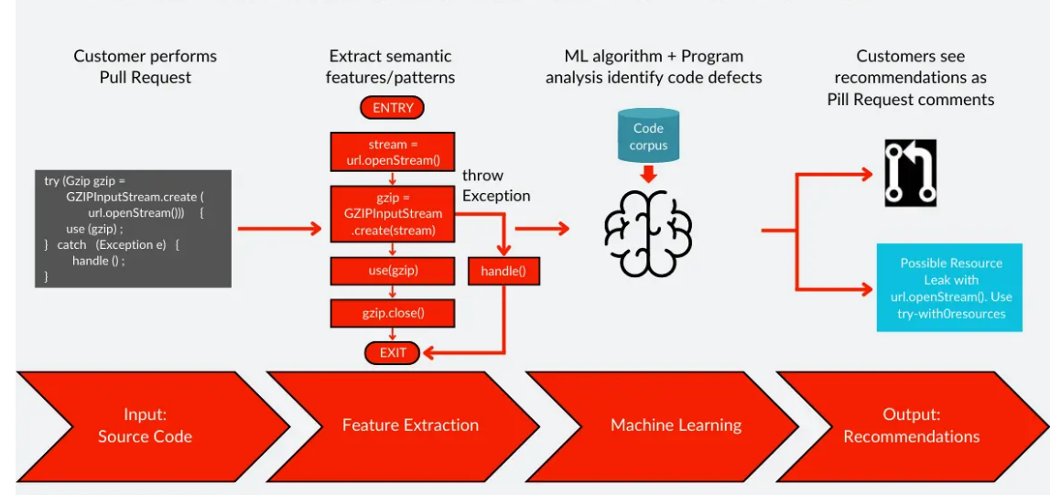
..

Slide 11
adv
Enhanced Code Quality: By leveraging machine learning, it identifies issues and suggests improvements, leading to higher-quality code. It helps catch potential bugs, security vulnerabilities, and performance bottlenecks before they impact end-users.
Faster Code Reviews: CodeGuru Reviewer automates the code review process, significantly reducing the time required for manual inspections. This allows developers to focus more on critical tasks and accelerates the overall development cycle.
Performance Optimization: CodeGuru Profiler identifies performance bottlenecks, enabling developers to optimize critical sections of code. This results in improved application performance, reduced latency, and better resource utilization.

Slide 12
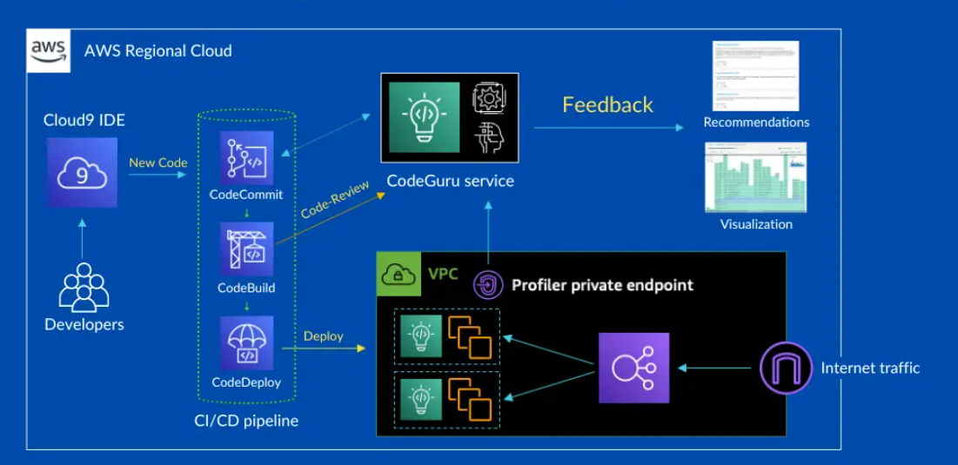
..

Slide 13
lab

